Slide 1








PROJECT
ON
Music Store
Management System

Slide 2


Introduction
The Music Store Database System optimizes daily retail operations by centralizing and organizing essential data in a structured SQL database.
The system supports store management, including customer relations, sales and billing, product inventory, employee tasks, and music library organization.
By providing a unified platform, the system eliminates the inefficiencies caused by scattered and redundant records, ensuring that information is consistent, accurate, and easily retrievable.
It enables store staff to track every detail of operations — from managing customer profiles and employee roles to monitoring product availability and processing invoices.
Additionally, the database maintains a rich catalog of music-related information, including artists, albums, tracks, genres, playlists, and media formats, allowing the store to meet diverse customer demands.
Let’s start!

Slide 3
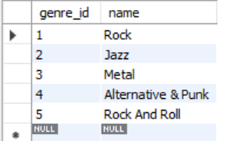
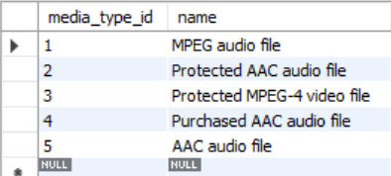
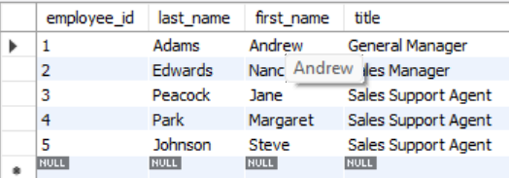
Tables
Genre Table
Media Type Table
Employee Table

Slide 4
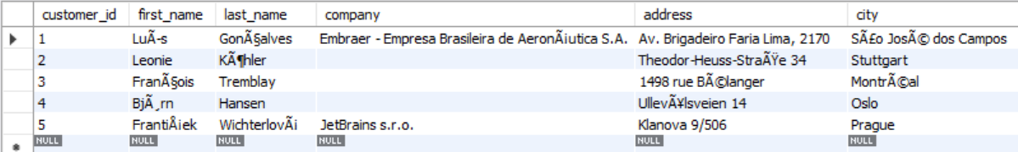
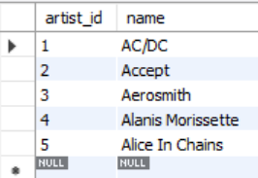
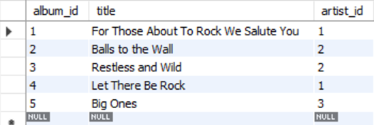
Customer Table
Artist Table
Album Table

Slide 5
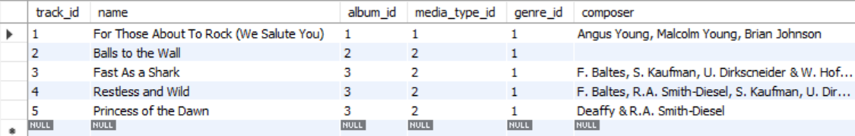
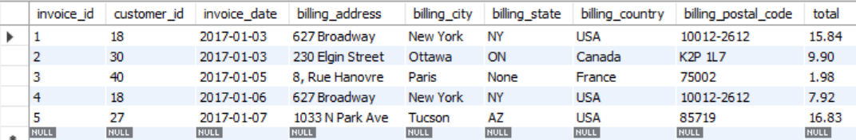
Track Table
Invoice Table

Slide 6
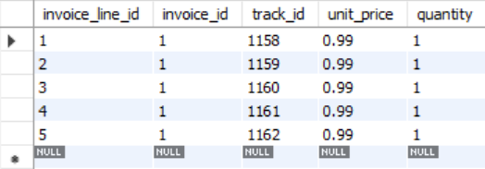
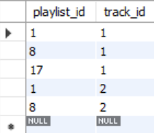
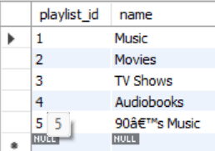
Invoice Line Table
Playlist Table
Playlist Track Table

Slide 7
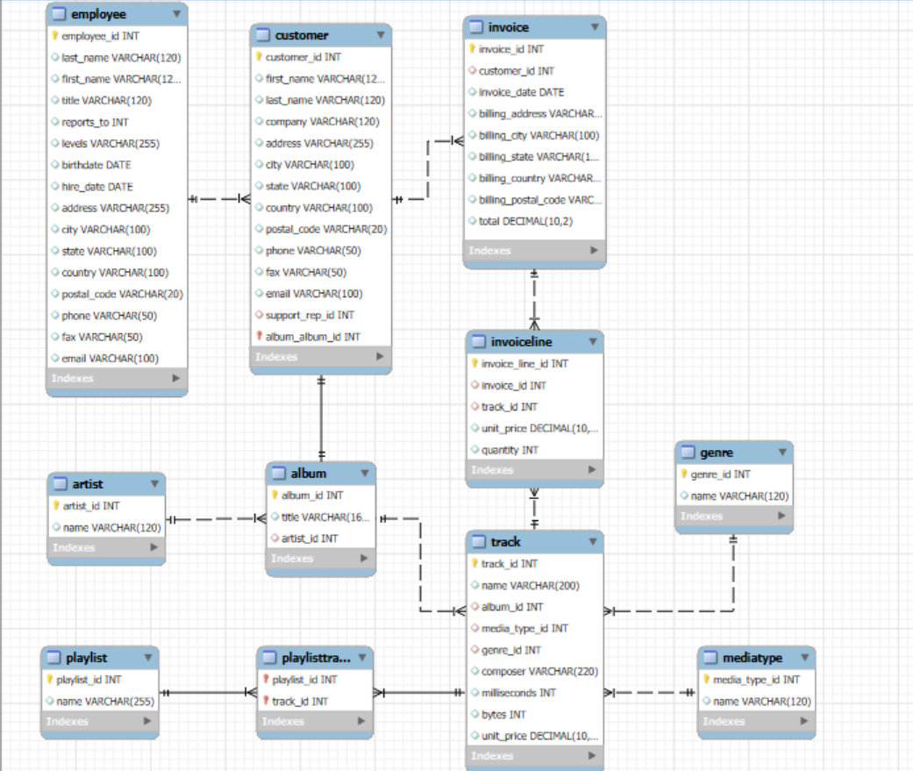

Er Diagram
Let’s start!

Slide 8
Problem Statement
In today’s competitive music retail environment, efficient data management on customers, employees, sales, and music products is essential. This project develops a relational database system to capture store activities and provide structured SQL access. It stores details on artists, albums, tracks, genres, media types, invoices, playlists, and links them with customers and employees.
The system supports complex queries to reveal top-selling tracks, best-performing albums, loyal customers, and seasonal sales trends, while enabling reporting, inventory monitoring, and playlist management. Using joins, aggregations, subqueries, indexing, and filtering, with a normalized schema, it ensures data integrity and minimal redundancy. The result is a scalable, reliable, and efficient system for both daily operations and strategic planning.

Slide 9
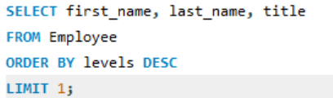

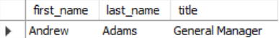
1. Who is the senior most employee based on job title?

Slide 10
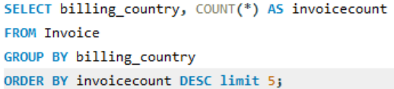
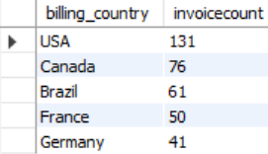

2. Which countries have the most Invoices?

Slide 11
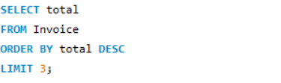
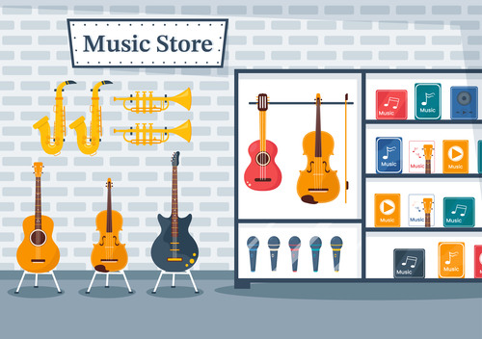
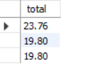
3. What are the top 3 values of total invoice?

Slide 12
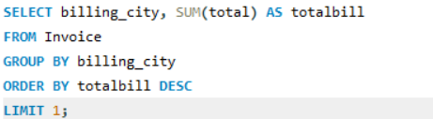
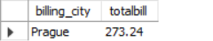
4. Which city has the best customers? - We would like to throw a promotional Music Festival in the city we made the most money. Write a query that returns one city that has the highest sum of invoice totals. Return both the city name & sum of all invoice totals

Slide 13
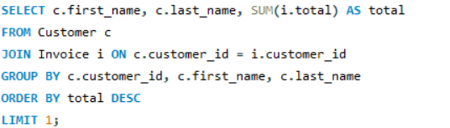
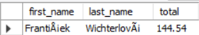
5. Who is the best customer? - The customer who has spent the most money will be declared the best customer. Write a query that returns the person who has spent the most money

Slide 14
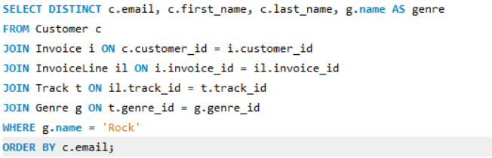
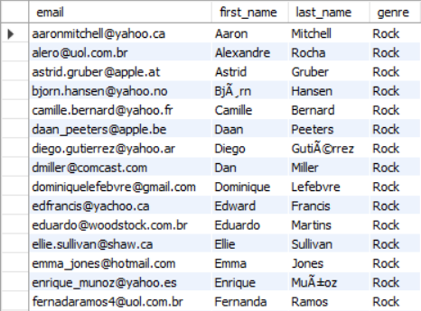
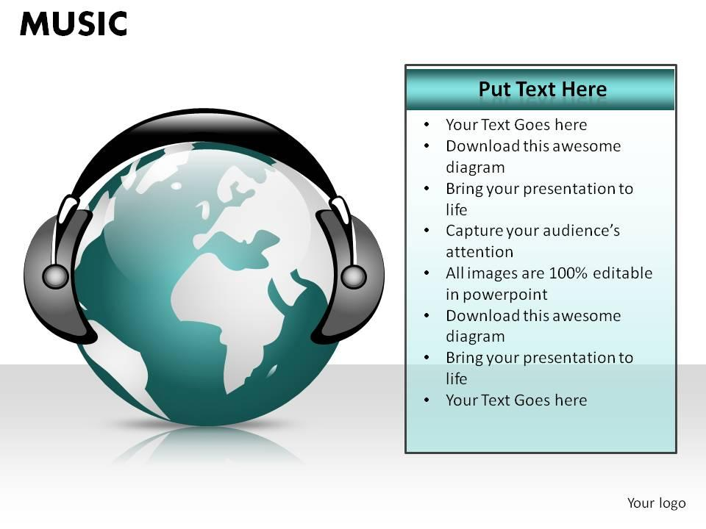
6. Write a query to return the email, first name, last name, & Genre of all Rock Music listeners. Return your list ordered alphabetically by email starting with A

Slide 15
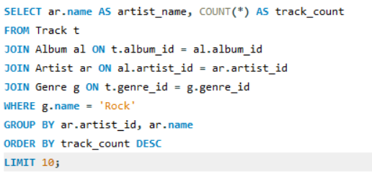

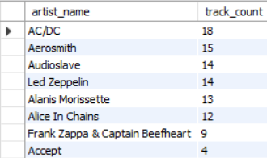
7. Let's invite the artists who have written the most rock music in our dataset. Write a query that returns the Artist name and total track count of the top 10 rock bands

Slide 16
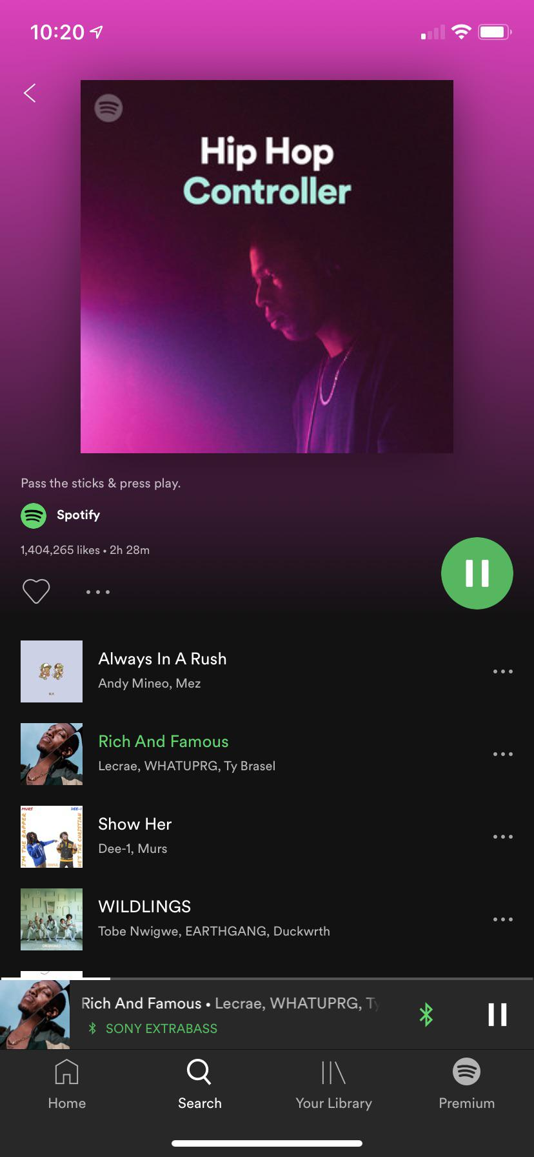
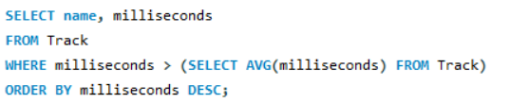
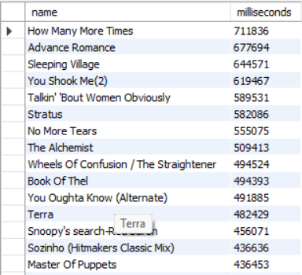
8. Return all the track names that have a song length longer than the average song length.- Return the Name and Milliseconds for each track. Order by the song length, with the longest songs listed first

Slide 17
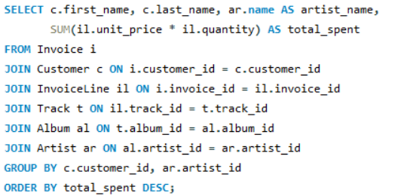
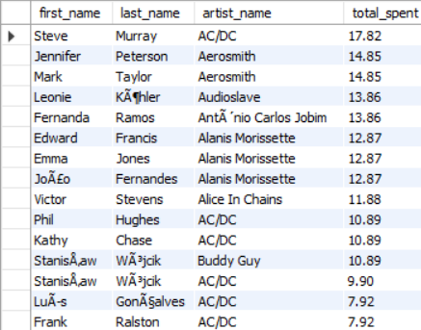

9. Find how much amount is spent by each customer on artists? Write a query to return customer name, artist name and total spent

Slide 18
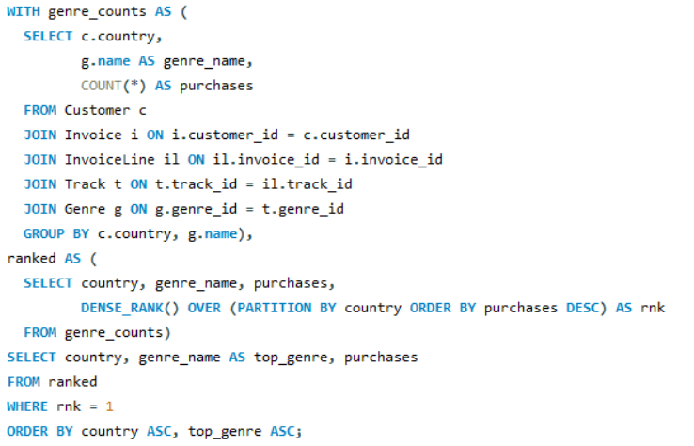
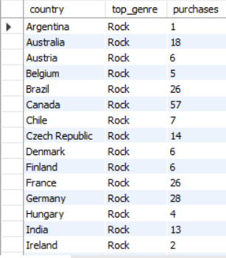
10. We want to find out the most popular music Genre for each country. We determine the most popular genre as the genre with the highest amount of purchases. Write a query that returns each country along with the top Genre. For countries where the maximum number of purchases is shared, return all Genres

Slide 19
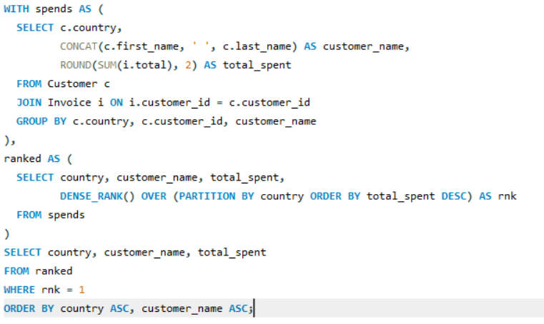
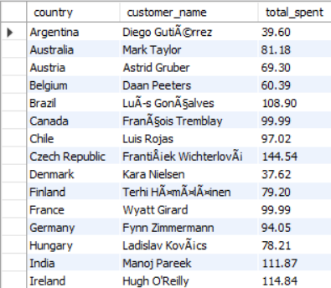
11. Write a query that determines the customer that has spent the most on music for each country. Write a query that returns the country along with the top customer and how much they spent. For countries where the top amount spent is shared, provide all customers who spent this amount

Slide 20
THANK YOU
Group Members:
S.Charan
N.Tejaswini
CH.Harshini

